Slide 1

The action-oriented approach and constructive alignment
CEFR Companion Volume implementation toolbox
Boîte à outils pour la mise en œuvre volume complémentaire du CECR

Slide 2
Using the illustrative descriptors of the CEFR Companion
Volume
Council of Europe (2020: 42):
“The main function of descriptors is to help align curriculum, teaching and assessment. Educators can select CEFR descriptors according to their relevance to the particular context, adapting them in the process if necessary.”
→ How does this impact curriculum planning?

Slide 3
Using the illustrative descriptors of the CEFR Companion
Volume – How does this impact curriculum planning?
Council of Europe (2020: 44):
“As mentioned, the primary function of descriptors is to facilitate the provision of transparent and coherent alignment between curriculum, teaching and assessment, particularly teacher assessment, and above all between the “language classroom world” and the real world. Real-world needs will relate to the main domains of language use: the public domain, the private domain, the occupational domain and the educational domain (CEFR 2001 Section 4.1.1; CEFR 2001 Table 5).”

Slide 4
Using the illustrative descriptors of the CEFR Companion
Volume – How does this impact curriculum planning?
Council of Europe (2020: 44):
“As mentioned, the primary function of descriptors is to facilitate the provision of transparent and coherent alignment between curriculum, teaching and assessment, particularly teacher assessment, and above all between the “language classroom world” and the real world. Real-world needs will relate to the main domains of language use: the public domain, the private domain, the occupational domain and the educational domain (CEFR 2001 Section 4.1.1; CEFR 2001 Table 5).”

Slide 5
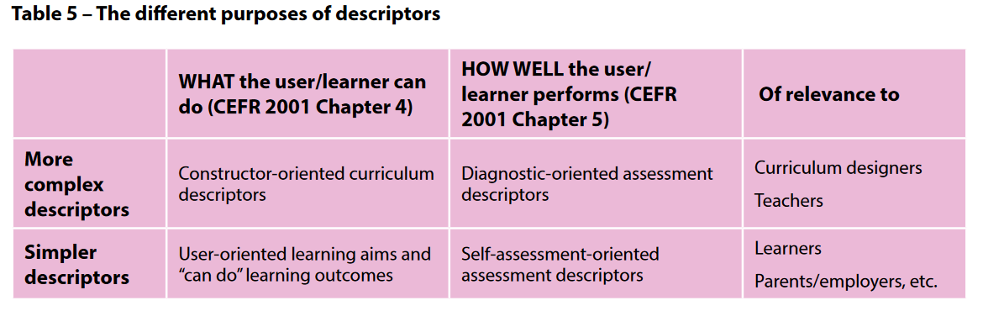
Using the illustrative descriptors of the CEFR Companion
Volume – How does this impact curriculum planning?
Council of Europe (2020: 44):

Slide 6
What is “constructive alignment”?
Biggs (2003: 2):
“'Constructive alignment' has two aspects. The 'constructive' aspect refers to the idea that students construct meaning through relevant learning activities. That is, meaning is not something imparted or transmitted from teacher to learner, but is something learners have to create for themselves. Teaching is simply a catalyst for learning: […]”
The 'alignment' aspect refers to what the teacher does, which is to set up a learning environment that supports the learning activities appropriate to achieving the desired learning outcomes. The key is that the components in the teaching system, especially the teaching methods used and the assessment tasks, are aligned with the learning activities assumed in the intended outcomes.”

Slide 7
What is “constructive alignment”?
Biggs (2003: 2):
“'Constructive alignment' has two aspects. The 'constructive' aspect refers to the idea that students construct meaning through relevant learning activities. That is, meaning is not something imparted or transmitted from teacher to learner, but is something learners have to create for themselves. Teaching is simply a catalyst for learning: […]”
The 'alignment' aspect refers to what the teacher does, which is to set up a learning environment that supports the learning activities appropriate to achieving the desired learning outcomes. The key is that the components in the teaching system, especially the teaching methods used and the assessment tasks, are aligned with the learning activities assumed in the intended outcomes.”

Slide 8
What is “constructive alignment”?
Biggs (2003: 2):
“'Constructive alignment' has two aspects. The 'constructive' aspect refers to the idea that students construct meaning through relevant learning activities. That is, meaning is not something imparted or transmitted from teacher to learner, but is something learners have to create for themselves. Teaching is simply a catalyst for learning: […]”
The 'alignment' aspect refers to what the teacher does, which is to set up a learning environment that supports the learning activities appropriate to achieving the desired learning outcomes. The key is that the components in the teaching system, especially the teaching methods used and the assessment tasks, are aligned with the learning activities assumed in the intended outcomes.”

Slide 9
What is “constructive alignment”?
Constructivist approach:
Learner agency to construct meaning and develop skills
Alignment of:
Learning objectives
Teaching and learning
Assessment
Coherent approach throughout curriculum

Slide 10
What is “constructive alignment”?
This addresses the following areas:
Needs analysis
Learning objectives (e.g. module descriptions)
Course syllabus
Assessment
Feedback

Slide 11
What is “constructive alignment”?
learning objectives
/ intended outcomes
teaching methods
assessment tasks
learning activities
needs analysis
See: Fischer / Wolder (2022): 198.

Slide 12
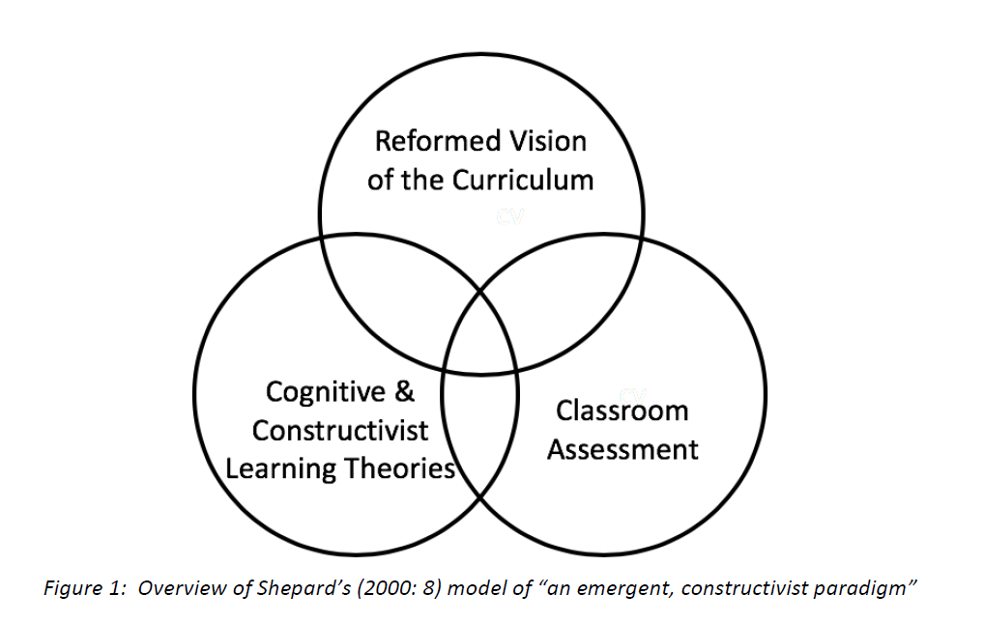
Constructive alignment
“The Comprehensive
Learning System”
(O’Sullivan 2020: 2,
based on Shepard 2000: 8)

Slide 13
The Action-oriented approach and
Constructive alignment
learning objectives
tasks / projects
feedback
teaching
assessment
Task-based (TBLT) and
action-oriented approach (AoA):
coherence between

Slide 14
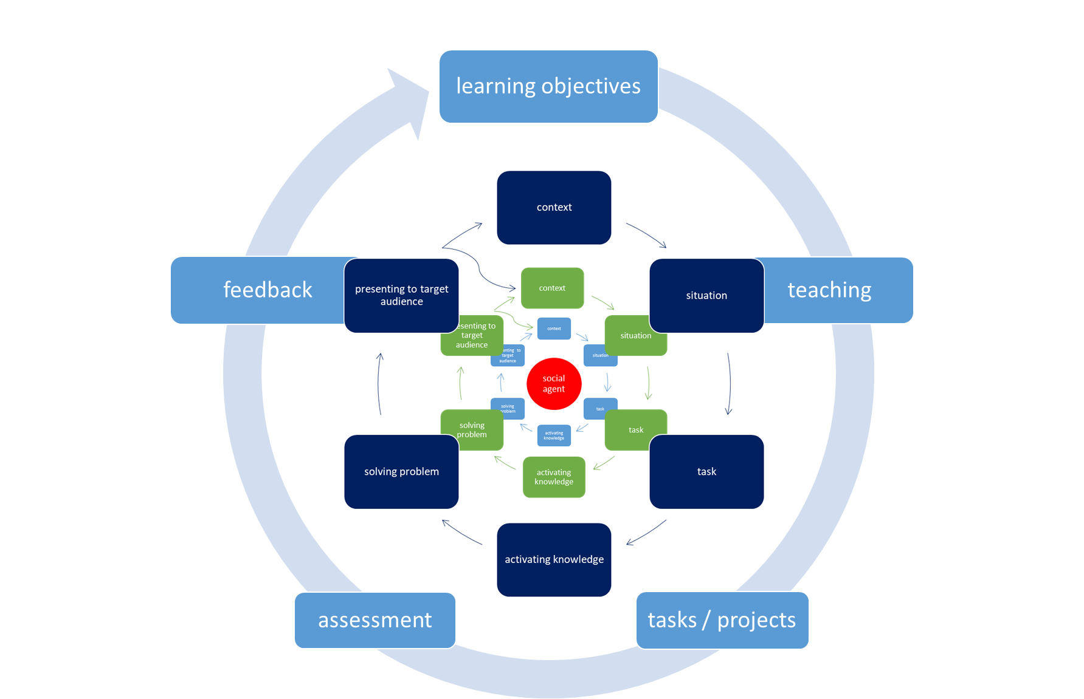
Constructive alignment
In this teaching – learning –
assessment cycle the learner
(as a social agent) is at the
centre of the activity,
co-constructing meaning with
their peers
See: Fischer / Wolder (2021): 10.
For more information on this diagram please have a look at the VITbox module on the action-oriented approach and the learner as a social agent.

Slide 15
Needs analysis
Needs of the various stakeholders:
Decision makers at international, national or regional level
Future employers
Institution
Teachers
Students
Others

Slide 16
Needs analysis
Participants’ profile
Target level
Purpose: type of language, purpose of the task / test (micro and macro level)
Interaction: participants’ role (interactions they will be involved in)
Instrumentality: medium, mode and channel of communication (written or spoken, variety of language, etc.).
Communicative event: real-life tasks to be represented

Slide 17
Defining learning objectives / intended outcomes
based on the results of the needs analysis
defining the targeted CEFR level, based on CEFR descriptors (adapted to specific needs)
module descriptions as a useful tool to describe
  learning objectives and intended outcomes
  admission criteria (e.g. entrance level)
  content
  methodology
  assessment: format, criteria, etc.

Slide 18
Constructive alignment and course design
Syllabus development – option 1:
Identifying needs
Defining the learning objectives (“intended learning outcomes”)
Specifying teaching methods
Developing teaching and learning activities
Developing assessment tasks
→ Assessment tasks need to be in line with the learning objectives, the classroom activities (teaching) and the learning.
(see also: Richards’ definition of “forward design” – Richards 2013)

Slide 19
Constructive alignment and course design
Syllabus development – option 2:
Identifying needs
Defining the learning objectives (“intended learning outcomes”)
Developing assessment tasks
Specifying teaching methods
Developing teaching and learning activities
→ Assessment tasks need to be in line with the learning objectives, the classroom activities (teaching) and the learning.
(see also: Richards’ definition of “backward design” – Richards 2013)

Slide 20
Constructive alignment – planning teaching activities
Specifying teaching methods
Developing teaching and learning activities:
  Defining projects
  Preparing blended learning input (inverted classroom), if applicable
  Preparing classroom activities
  Preparing self and peer assessment as well as formative assessment activities
  Defining feedback strategies
  Applying either forward design or backward design, or a combination of both

Slide 21
Constructive alignment – an action-oriented approach to assessment
action-oriented
task-based
based on a realistic, relevant and meaningful scenario
in line with the teaching activities
test-takers act as social agents
  using their individual knowledge and skills
  and contributing to the development of relevant and meaningful outputs / products

Slide 22
The added value of constructive alignment
transparency
harmonisation of teaching and assessment practices
puts things into perspective
more meaningful and increased face validity
increased satisfaction rate of students, teachers and future employers
increase in motivation of learners and test-takers
etc.

Slide 23
Constructive alignment – Bibliography
Biggs, John B. (1996). Enhancing teaching through constructive alignment. In: Higher Education No 32, 247-264.
Biggs, John B. (2003). Aligning teaching for constructing learning. In: The Higher Education Academy: https://www.advance-he.ac.uk/knowledge-hub/aligning-teaching-constructing-learning (online publication).
Fischer, Johann / Wolder, Nicole (2021). Erfahrungen in der Umsetzung der Inhalte des Begleitbands zum GeR im Hochschulkontext – Ergebnisse eines Projektes des Europarates und Handlungsbedarf für Hochschulsprachenzentren. Fremdsprachen und Hochschule 96, 7-27.
Fischer, Johann / Wolder, Nicole (2022). Implementation of the CEFR Companion Volume in the UNIcert® and NULTE Networks. In: North, Brian / Piccardo, Enrica / Goodier, Tim / Fasoglio, Daniela / Margonis-Pasinetti, Rosanna / Rüschoff, Bernd (eds.): Enriching 21st century language education. The CEFR Companion Volume in practice, Strasbourg: Council of Europe Publishing, 185-201; https://rm.coe.int/enriching-21st-century-language-education-the-cefr-companion-volume-in/1680a68ed0.
Graves, Kathleen (2008). The language curriculum: A social contextual perspective. In: Language Teaching 41 (2), 147-181.
Green, Anthony (2016). Assessment literacy for language teacher[s]. In: Dina Tsagari (ed.), Classroom-based Assessment in L2 Contexts. Cambridge: Cambridge Scholars Publishing. 8-29.
O’Sullivan, Barry (2020). The Comprehensive Learning System. British Council: https://www.britishcouncil.org/sites/default/files/cls_bcps1_bos_30-09-2020_final.pdf
(online publication)
Richards, Jack C. 2013. Curriculum approaches in language teaching: Forward, central and backward design. In: RELC Journal 44 (1). 5-33.

